Slide 1


Node js Lecture 1
National Telecommunication Institute
Ministry of Communications and Information Technology

Slide 2
Agenda
Web
What is Node.js
Node.js vs Browser
global, REPL, Argv
Core Modules(fs)

Slide 3
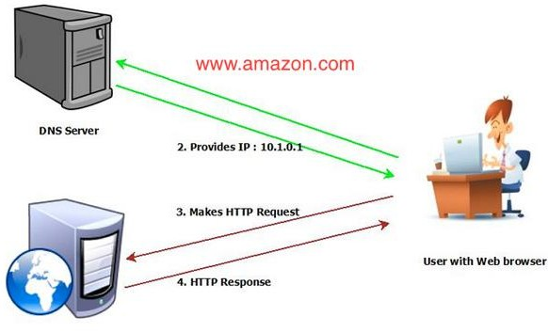

Slide 4
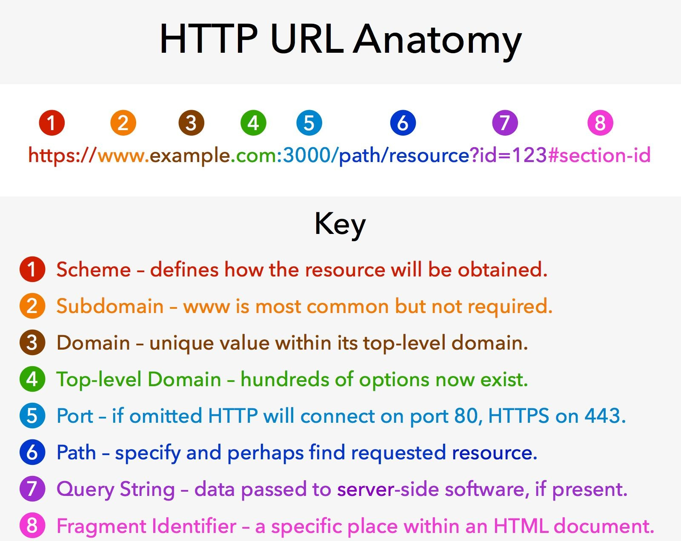

Slide 5
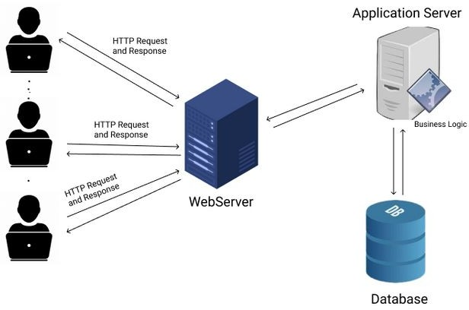

Slide 6
Node js:
Node is a runtime environment for executing JS code.it’s not a programming language.Node is a C++ program that embeds Chrome’s v8 engine, the fastest JS engine in the world.
Node.js uses an event-driven,
non-blocking I/O model, which makes it lightweight.
Node js is single thread (single threaded but highly scalable).
In Node, we don’t have browser environment objects such as window or the document object. Instead, we have other objects that are not available in browsers, such as objects for working with the file system, network, operating
system, etc
Node created by Ryan Dahl in 2009.
its an Open Source, Cross-platform, runtime environment for server- side and a high performance networking applications.
Popular companies using node js: Netflix,Nasa,Trello,Paypal,Linkedin
,Uber,....
Last version :22.3.0

Slide 7
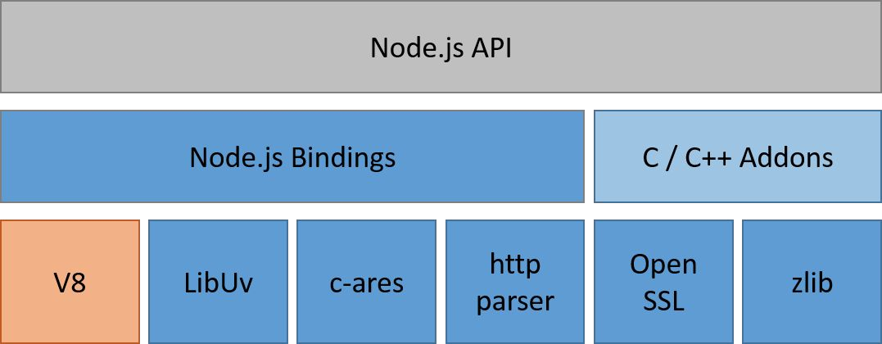

Slide 8
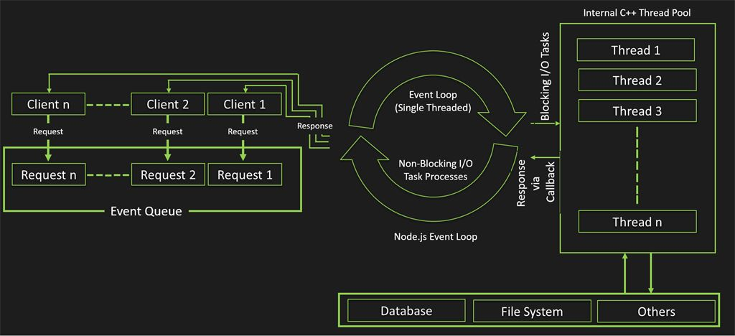

Slide 9
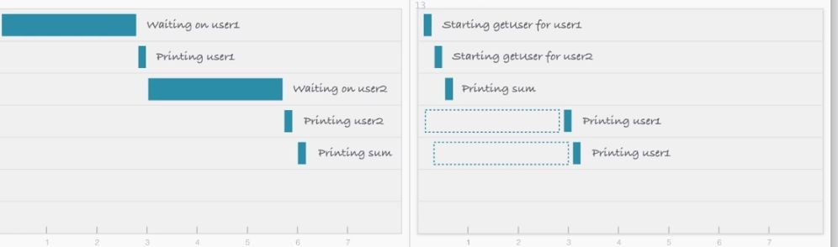
Blocking vs non-Blocking
Consider a scenario where we request a backend database for the details of
user1 and user2 and then print them on the screen/console. The response to
this request takes time, but both of the user data requests can be carried out
independently and at the same time

Slide 10
When to use node js?
Node.js is good for creating streaming based real-time services, web chat applications, static file servers etc .
If your server side code requires very few cpu cycles. In other words you are doing non blocking operation and does not have heavy algorithm/Job which consumes lots of CPU cycles.
Following are the areas where Node.js is perfect technology:
-I/O bound Applications
-Data Streaming Applications
-Data Intensive Real time Applications (DIRT)
-JSON APIs based Applications

Slide 11
When not to use node js?
When you are doing heavy and CPU intensive calculations on server side, because event-loops are CPU hungry , like : images manipulating , video conversion or file compression

Slide 12
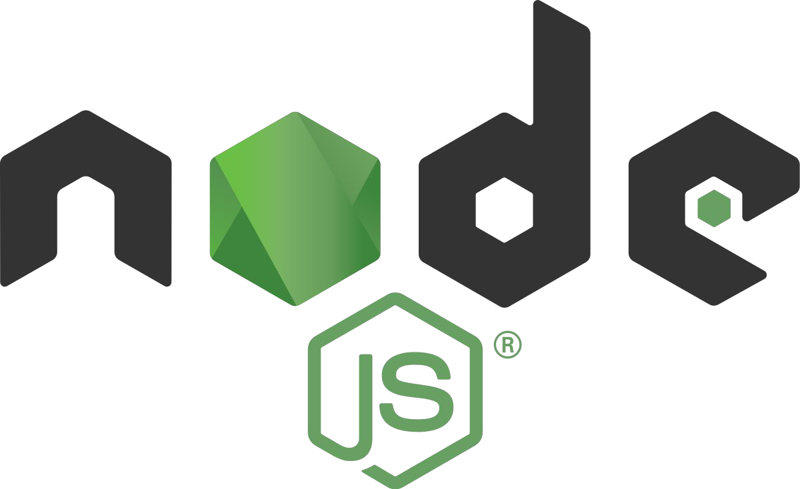
Getting Started
Install node js:
https://nodejs.org/en/download/
After downloading it, you have to install it.
Enter your folder and run your app :
node (entry point)

Slide 13
IntRo to Modules :
Module is a self contained series of one or more .js files presented by an object
Modules is where we can encapsulate related functionality into a single file
Modules act as libaries
It’s a set reusable code that adds extra functionality to our application
Node provides core modules that can be included by their name:
File System – require(‘fs’)
Http – require(‘http’)
Utilities – require(‘util’)

Slide 14
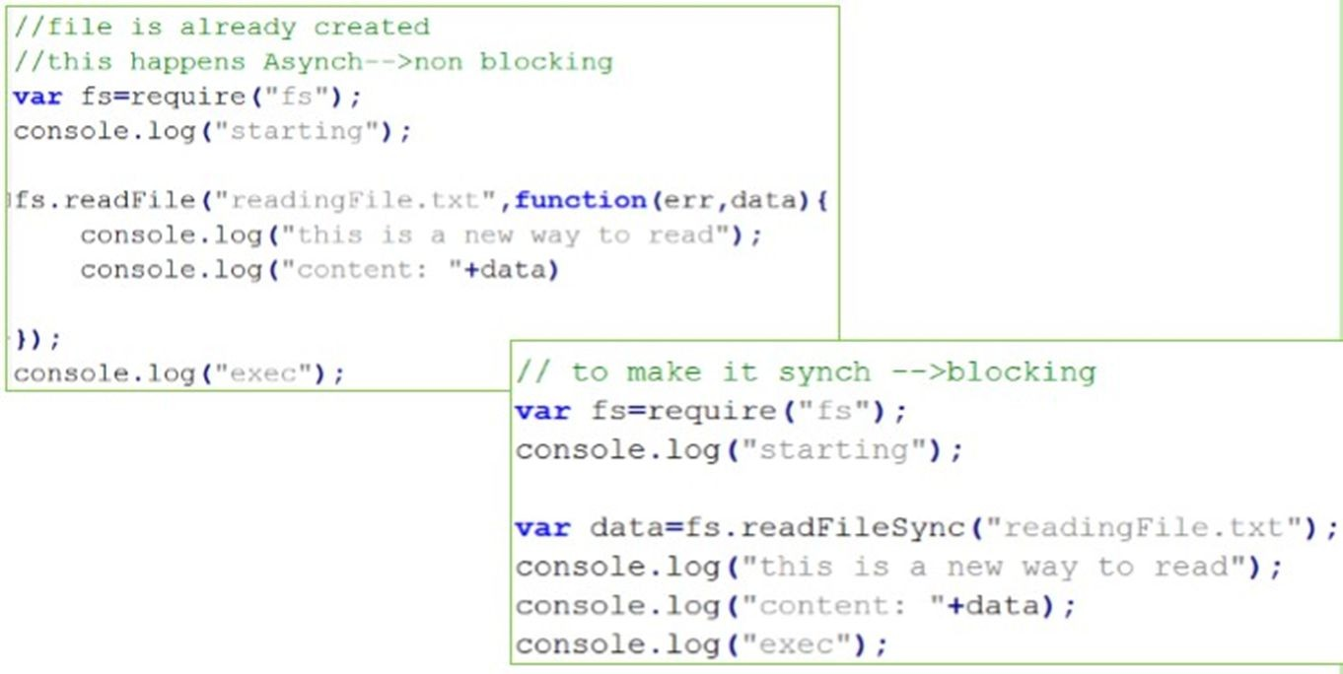
FS Module:

Slide 15
JS in browser and Node.js Node REPL
Node Global Objects

Slide 16
Thank you

